Slide 1


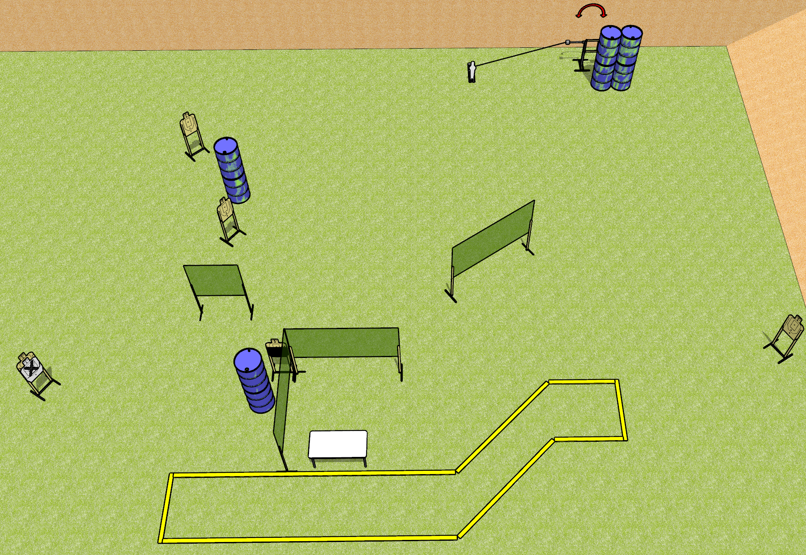
 | Dothan Gun Club – USPSA Match Shaped Up Course Designer : Drew Coleman
Round Count 13 rounds 6 USPSA 1 mini popper
Equipment List 4 medium fault lines 1 swinger + activator 1 50% 6 paper (5 + 1 NS)

Slide 2
Shaped Up
Written Stage Briefing
Shaped Up is a 13 round, 65 point, Comstock course of fire. There are 6 USPSA targets and 1 mini popper. The best 2 hits on paper will score, and steel must fall to score. The start signal is audible.
The swinger is activated by the mini popper and remains visible at rest.
Start position is behind rear fault line, completely outside the shooting area. Firearm is loaded on table, trigger guard on mark, not propped in any way.
On start signal, engage targets as they become available from within the shooting area.

Slide 3
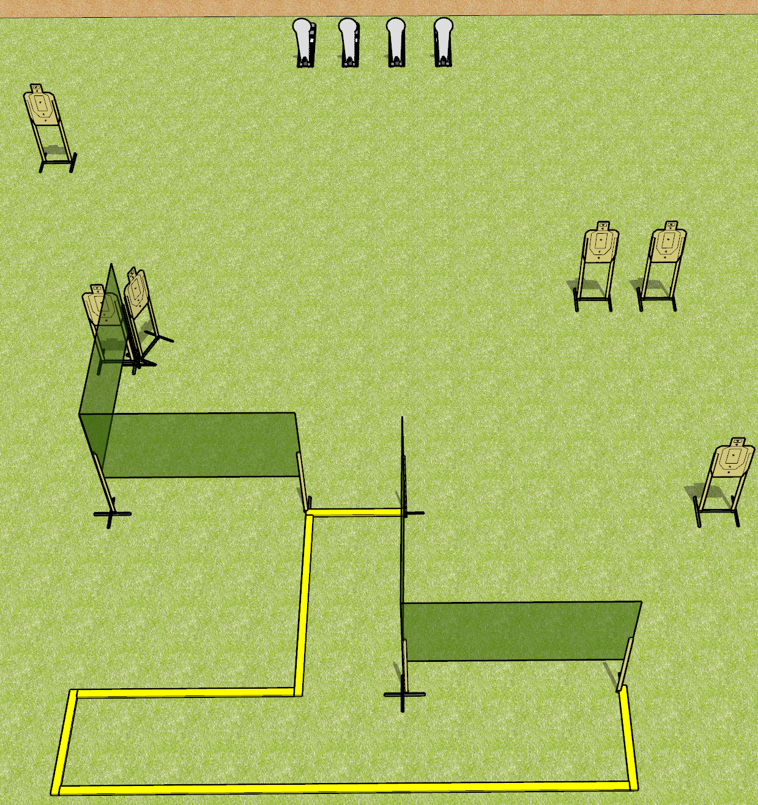
 | Dothan Gun Club – USPSA Match Hang On, What? Course Designer : Drew Coleman
Round Count 16 rounds 6 USPSA targets 4 colt poppers
Equipment List 3 medium fault lines 6 wall feet

Slide 4
Hang On, What?
Written Stage Briefing
Hang On What is an 16 round, 80 point, Comstock course of fire. There are 6 USPSA targets and 4 colt poppers. The best 2 hits on paper will score, and steel must fall to score. The start signal is audible.
Handgun start position is inside shooting area, wrists below belt. Handgun is UNLOADED and holstered.
PCC start position is inside shooting area, stock on belt. UNLOADED carbine is held with both hands.
On start signal, engage targets as they become available from within the shooting area.

Slide 5
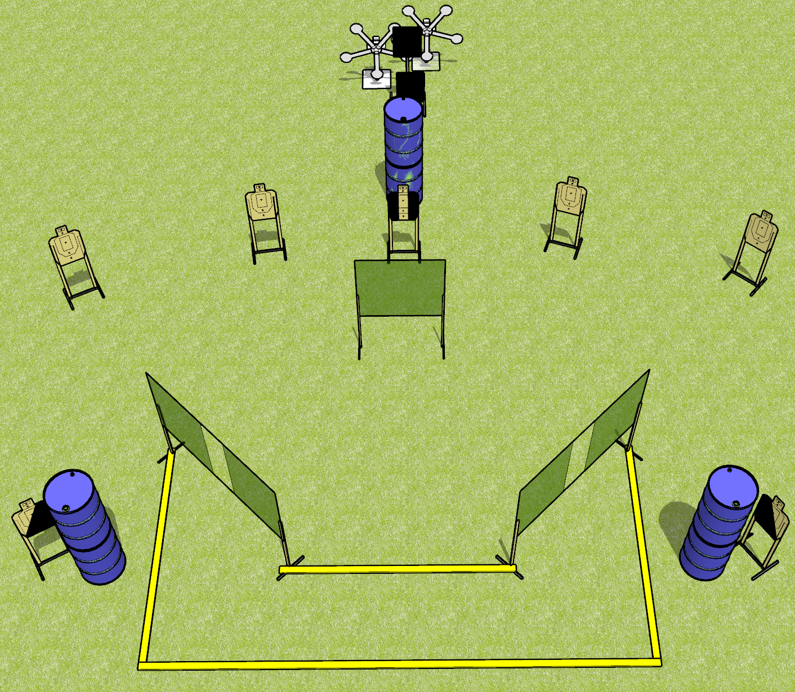
 | Dothan Gun Club – USPSA Match Double Trouble Course Designer : Drew Coleman
Round Count 24 rounds 7 USPSA 10 falling plates
Equipment List 6 wall feet 2 Texas stars 1 left + 1 right diag, 1 tux 4 targets

Slide 6
Double Trouble
Written Stage Briefing
Double Trouble is a 24 rounds, 120 point, Comstock course of fire. There are 7 USPSA targets and 10 falling plates. The best 2 hits on paper will score, and steel must fall to score. The start signal is audible.
Handgun start position is completely outside the shooting area, wrists below belt. Handgun is loaded and holstered.
PCC start position is completely outside the shooting area, stock on belt. Loaded carbine is held with both hands, safety on.
On start signal, engage targets as they become available from within the shooting area.

Slide 7
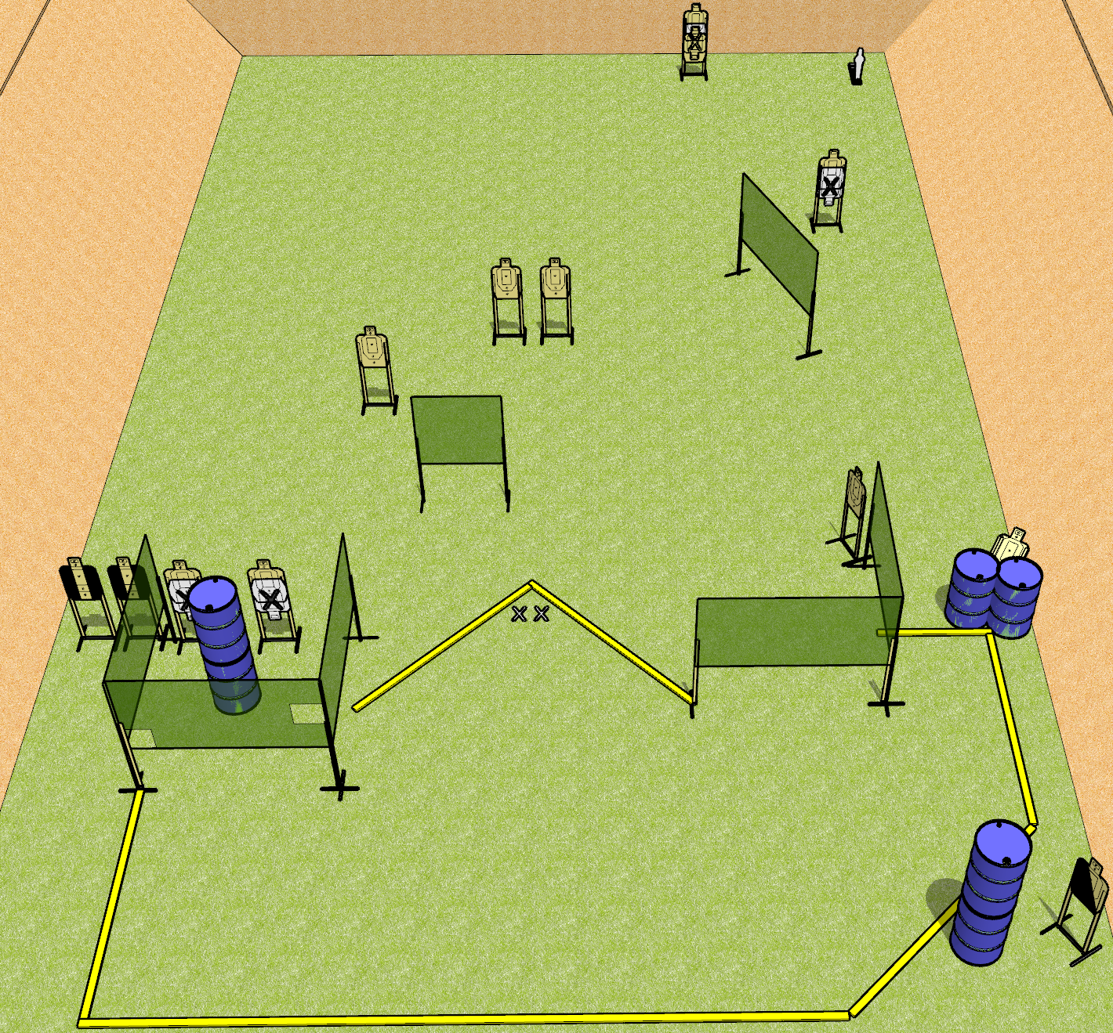
 | Dothan Gun Club – USPSA Match The Weird One Course Designer : Drew Coleman
Round Count 27 rounds 13 USPSA 1 mini popper
Equipment List 1 medium fault line 11 wall feet 2 tuxes, 1 left diagonal 14 targets (11 scoring + 3 NS)

Slide 8
The Weird One
Written Stage Briefing
The Weird One is a 27 round, 135 point, Comstock course of fire. There are 13 USPSA targets and 1 mini popper. The best 2 hits on paper will score, and steel must fall to score. The start signal is audible.
Handgun start position is toes on X’s, facing down range, wrists below belt. Handgun is loaded and holstered.
PCC start position is toes on X’s, facing down range, stock on belt. Loaded carbine is held with both hands, safety on.
On start signal, engage targets as they become available from within the shooting area.

Slide 9
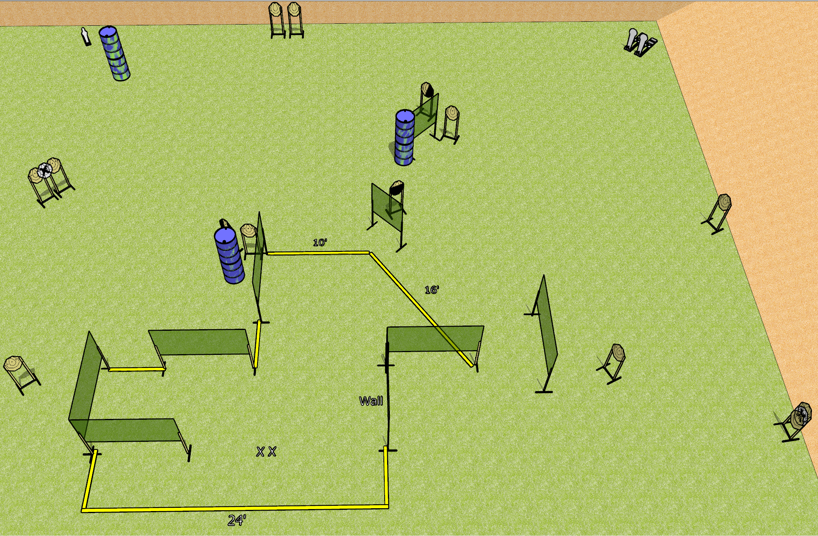
 | Dothan Gun Club – USPSA Match Crazy Face Course Designer : Drew Coleman
Round Count 31 rounds 14 IPSC 2 colt poppers, 1 mini popper
Equipment List 4 medium fault lines 16 wall feet 1 tux, 1 right diag, 1 50% 13 paper (11 + 2 NS)

Slide 10
Crazy Face
Written Stage Briefing
Crazy Face is a 31 round, 155 point, Comstock course of fire. There are 14 IPSC targets, 2 colt poppers, and 1 mini popper. The best 2 hits on paper will score, and steel must fall to score. The start signal is audible.
Handgun start position is feet on X’s, wrists below belt. Handgun is loaded and holstered.
PCC start position is feet on X’s, stock on belt. Loaded carbine is held with both hands, safety on.
On start signal, engage targets as they become available from within the shooting area.

